Slide 1



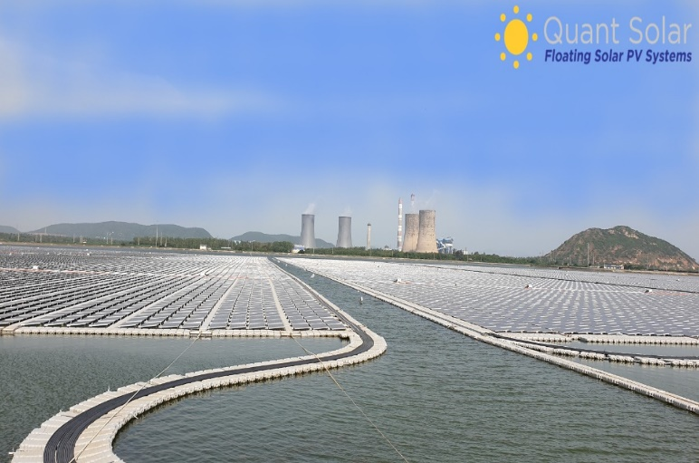
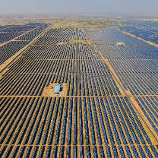
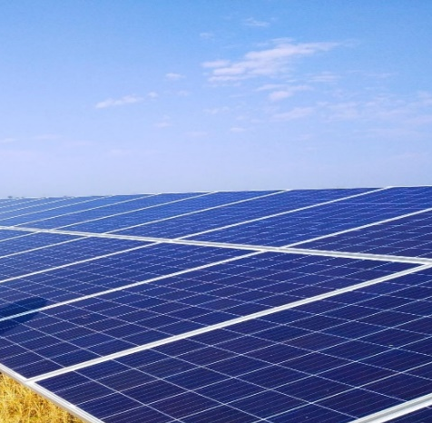
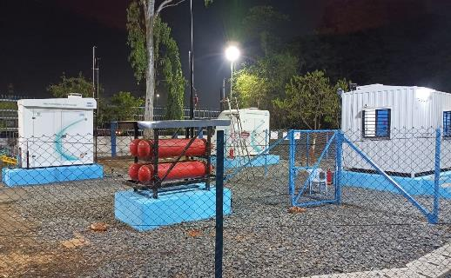
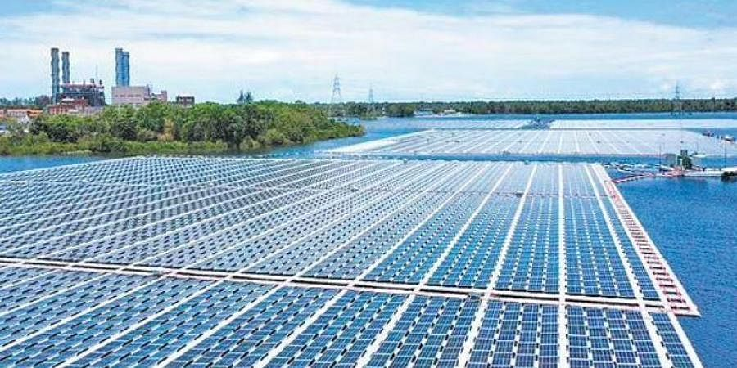
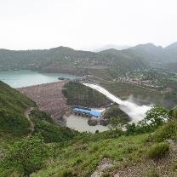
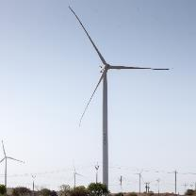
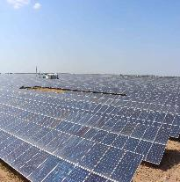
NTPC Simhadri Floating
NTPC Bhadla
NTPC140MW Bilhaur
NTPC Kawas Green Hydrogen Blending
NTPC Kayamkulam Floating
Green Hydrogen Blending in PNG (upto 8%) and Green Hydrogen based Microgrids in Himalayas
P Rahul | Sr. Manager | NTPC
NTPC Koldam
NTPC Rojmal
NTPC Fatehgarh
Follow us on:
/ntpc1
/ntpcltd1
/ntpclimited
/Company/ntpc
/ntpclimited

Slide 2

Green Hydrogen Blending in PNG
First time upto 8% in the country

Slide 3
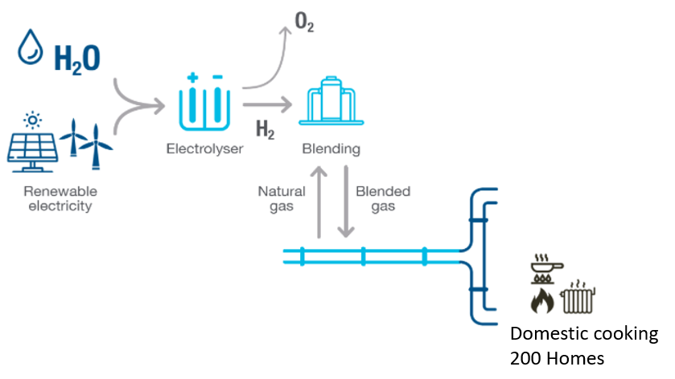
1
3
System Performance
4
Objective and Features
2
Project Details
Assessments
5
Learnings

Slide 4

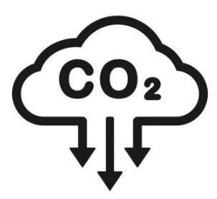
Need for Hydrogen Blending
Energy Security
Decarbonation

Slide 5
Objectives
India’s 1st Green Hydrogen
Blending with Natural Gas
Technical validation
System Design
Execution and Operation
Safety requirements
Standards & Regulations
Understands the Impact of hydrogen blending
Gas assessment
Material structure assessment
Understanding user’s concerns and perception
NTPC kawas Township, Surat, Gujarat
Notes:
Features
200 kg of CO₂ eq / year can be mitigated
Import substitution
Decentralized decarbonization of gas-based end-use application

Slide 6
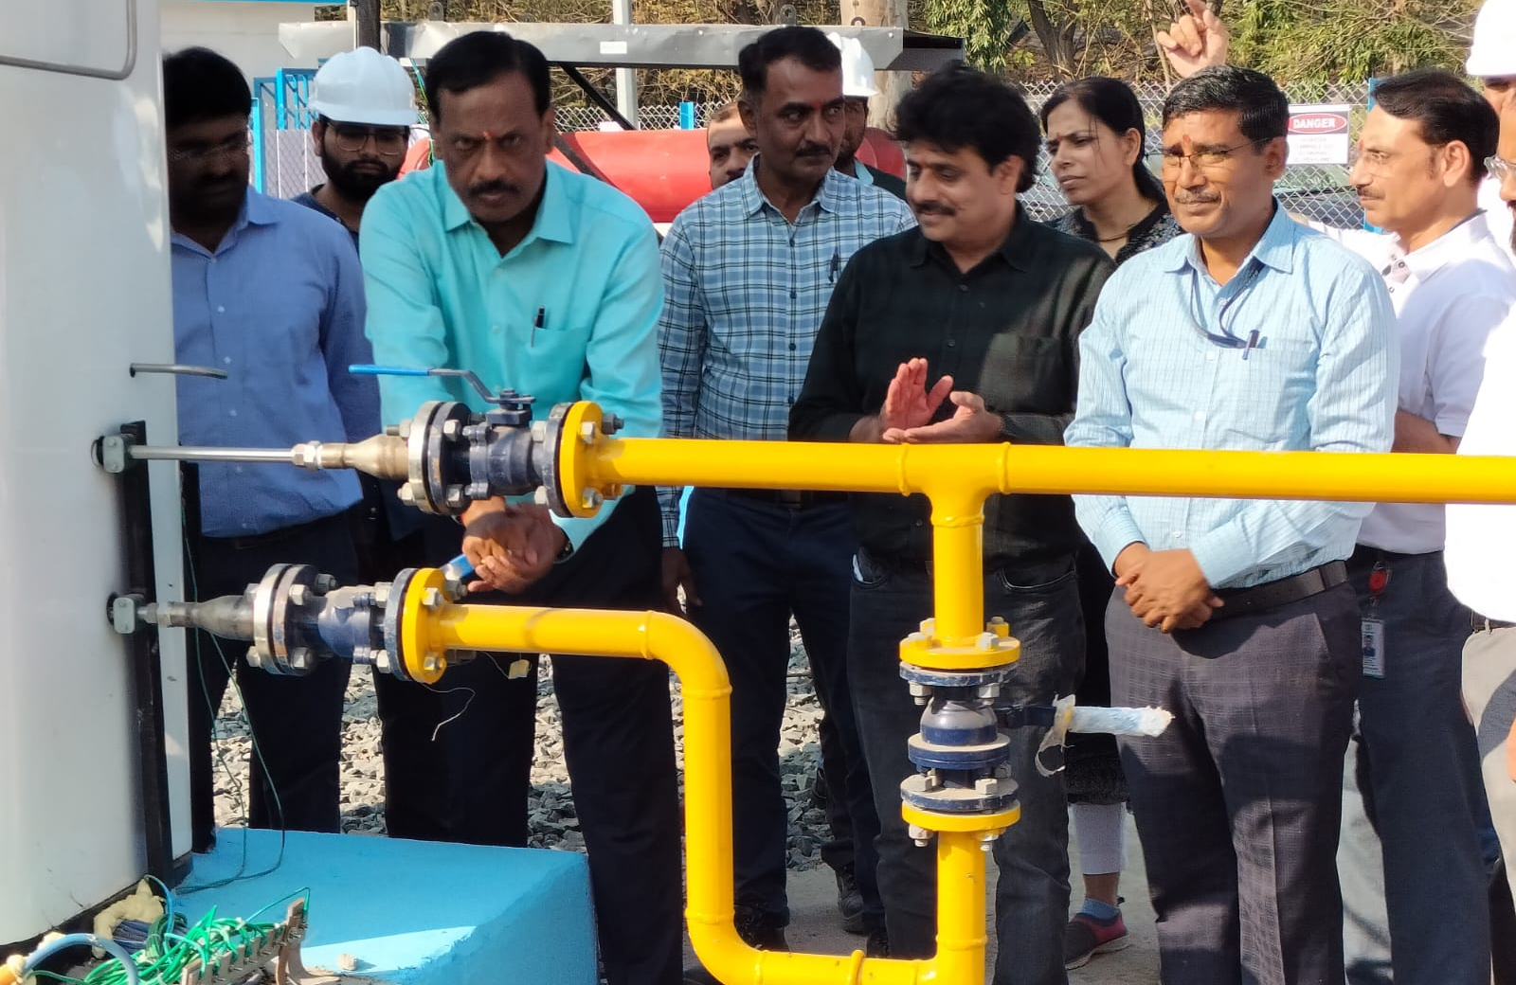
Project Details
Electrolyzer : PEM (Min 1 nm³/hr.)
H₂ storage : 13 nm³ (640 WL) at 30 bar(g)
H₂ blending : Active and Monitor, PID c/v, H₂ Analyzer
Safety Studies : HAZOP, HAC, QRA, EMERA
PNG Network : Gujarat Gas Limited Surat GA
Blending Level : H₂ at 5-20% v/v
RE Power : Floating Solar (NTPC Kawas)
Household : 200 nos.
Scheme
Commissioned on 02nd Jan 2023

Slide 7
Safety Provisions
Standards Compliance
Electrical: IS 5571, IS 3043, IP Std Compliance
Instrumentation & Control System : API RP, EN 334, EN 14382
Piping Standards: OISD 118, ASME B31.12 and B31.3, PNGRB T4S Guidelines
Storage Cylinder – PESO GCR 2016
Safety Valves : ASME UV stamped
Safety System
Provision of Active and Monitor Pressure regulator
Emergency Shutdown for overpressure protection and leakage detection
Online analyser (H2, NG, and blended gas) for feedback control & protection
Safe shutdown of system (in-case of power supply failure)
Gas detectors for H2 and NG at strategic locations
Safety devices (flame arrester) in all venting points

Slide 8
System Performance

Slide 9
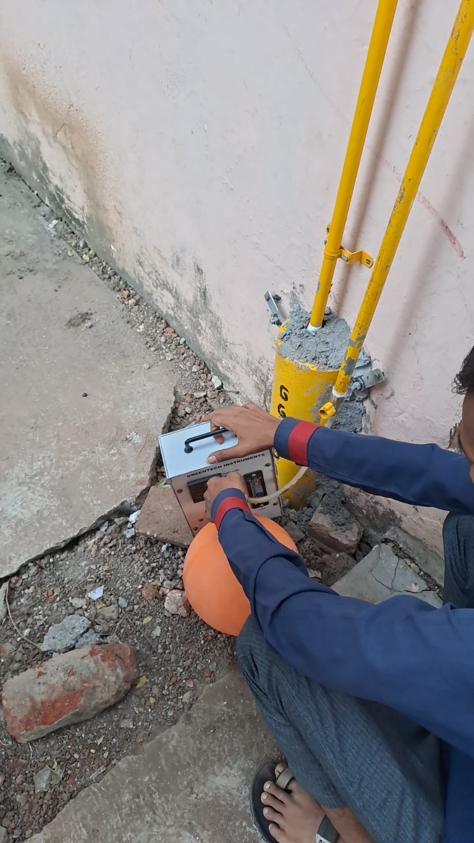
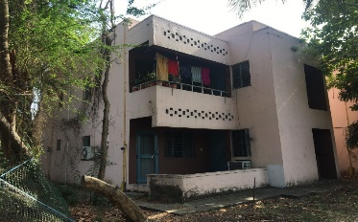
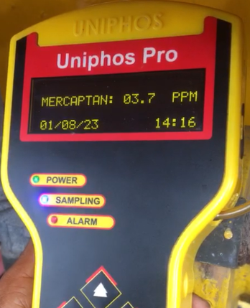
Gas Assessment – Composition & Odourant
Analysis Result at 5% Hydrogen blending with PNG
Month | Sample location | Hydrogen %
Jul-23 | Blending | 5.03
 | Farthest | 4.9
 | Highest | 4.92
Aug-23 | Blending | 4.81
 | Farthest | 4.62
 | Highest | 4.69
Purpose : Composition (Homogeneity)
Frequency : Every Month
Samples : 3 Samples
(blending skid, highest, farthest)
Gas Composition
Test (dummy) riser
Month | Ethyl Mercaptan (ppm)
Jun-23 (week) | Before blending | After blending
First | 2.3 | 2.2
Second | 2.2 | 2.2
Third | 2.3 | 2.3
Fourth | 2.4 | 2.4
Purpose : Dilution Effect
Frequency : Every blending level
Samples : 4 Samples
(once in a week)
Odourant Dilution
Odourant Testing
8

Slide 10
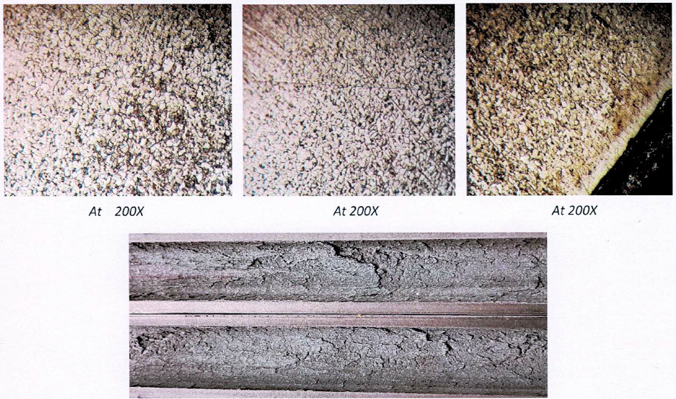

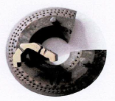
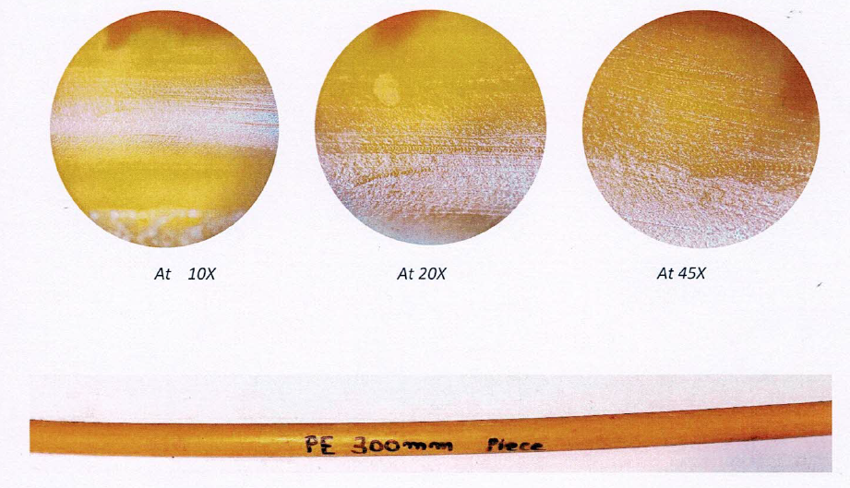
Material Assessment in PNG Network
Microscopic
Purpose : Composition (Homogeneity)
Frequency : Every 3 Month
Samples : Polyethylene, Galvanised pipe, Burner, Rubber seal
Galvanised
pipe
Material | Test / Analysis | Inference
Galvanised pipe | Composition | No variation
 | Tensile test | No variation
 | Corrosion mapping | No adverse effects
 | Macro structure | No discontinuity
Rubber seal | Compatibility test | No adverse effects
Burner | Macro structure | No discontinuity
Polyethylene pipe | Corrosion mapping | No adverse effects
 | Macrostructure | No discontinuity
Burner
Polyethylene
9

Slide 11
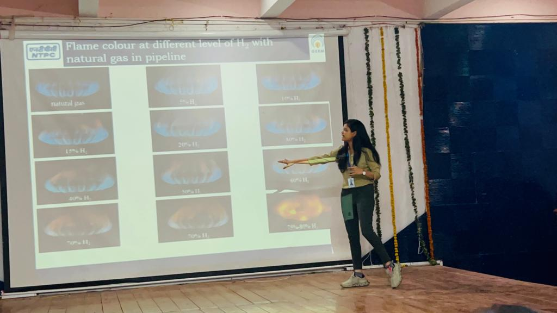
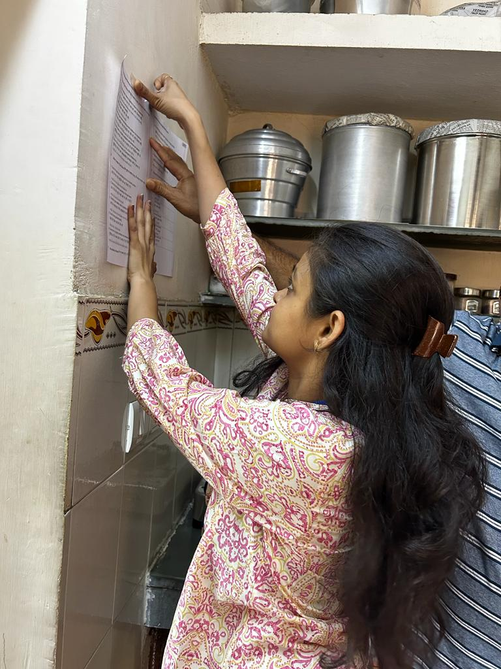
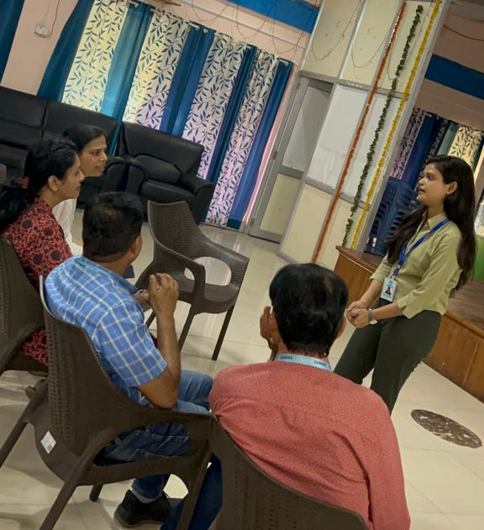
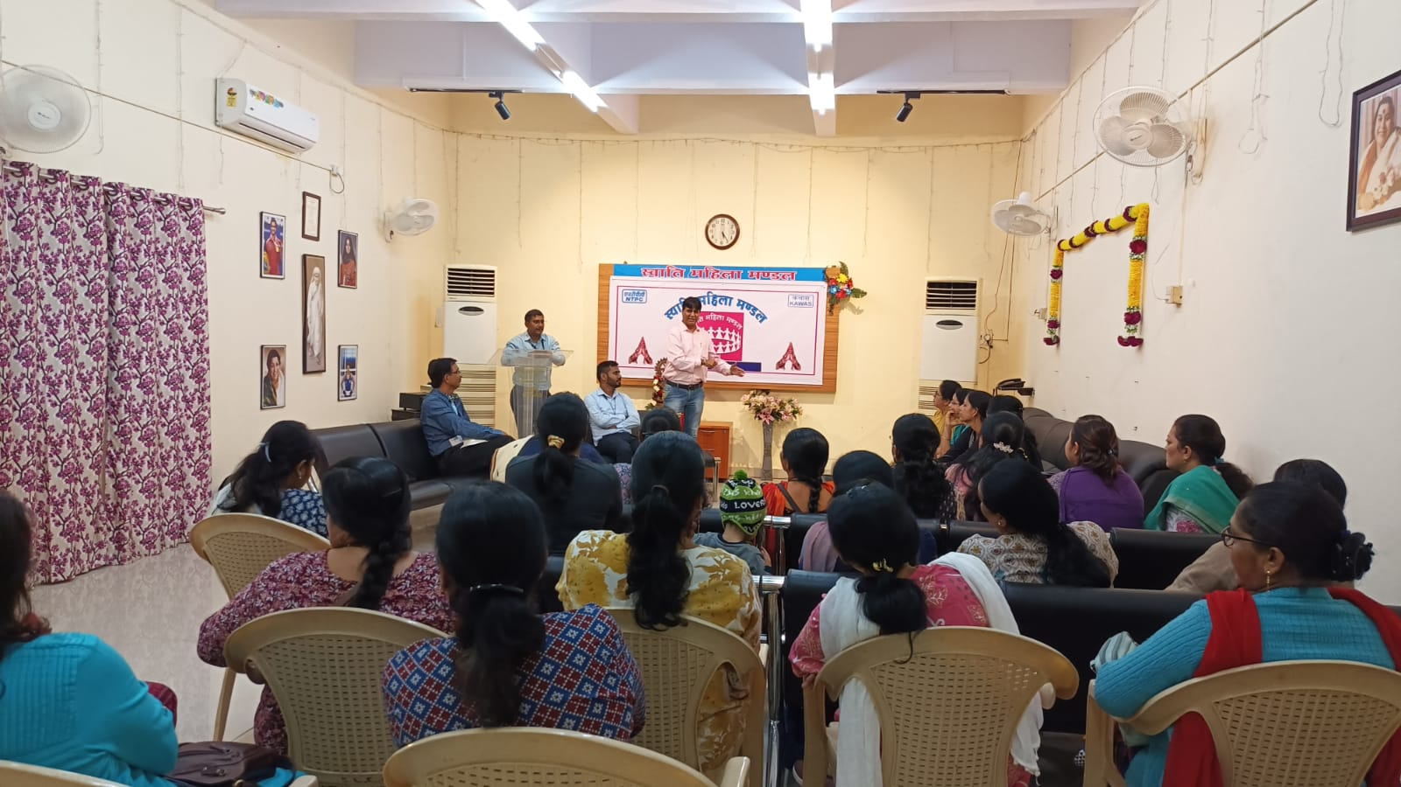

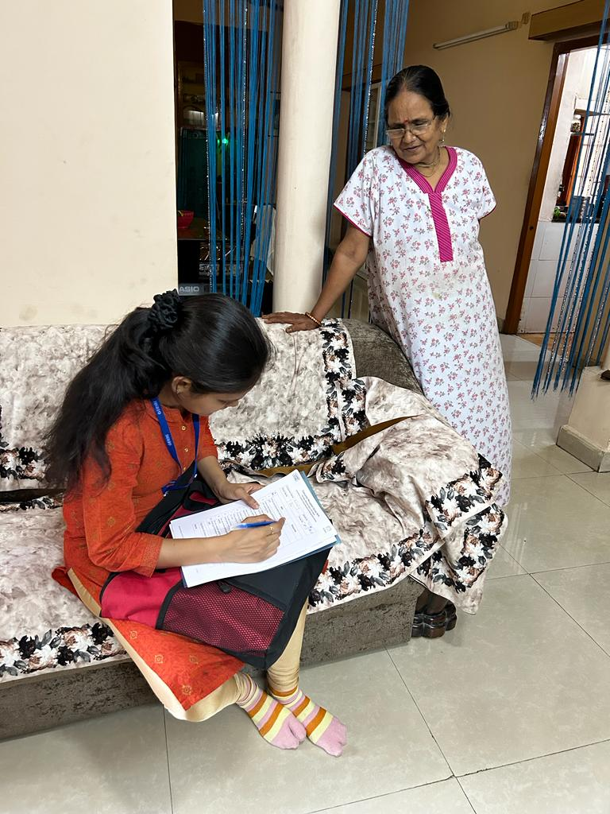
Training and Consumer Survey
10

Slide 12

Learnings
Outcomes
Fail Safe Design
Standardised technical Specifications
Checks during commissioning and operation
Evaluation and performance
Impact/Assessment of the PNG network
Optimization of economics
Risk Assessment & Mitigation
Let's drive sustainability together and create value for our business
Notes:
AG&P – Obtained Geographical Authorisation from PNGRB for 3 districts in Kerala: Alappuzha, Kollam, Trivandrum

Slide 13
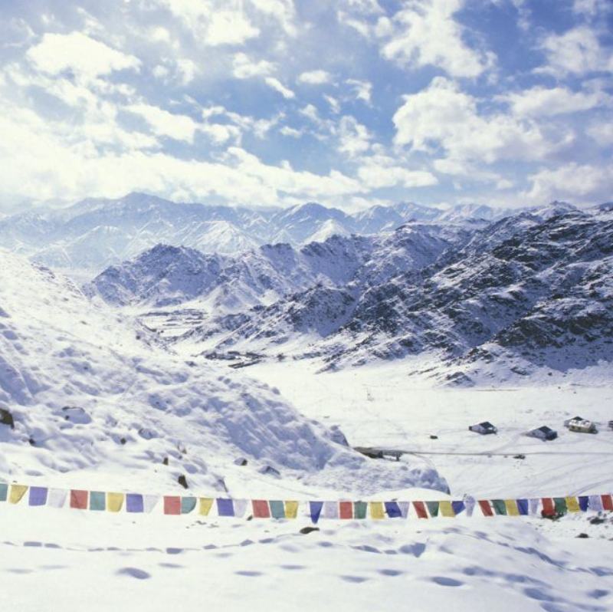
Green Hydrogen based Microgrid in the Himalayas
1
3
About the High Altitude Project
4
About GH2 based Microgrids
2
Comparison vis a vis DG
Monthly energy Profiles
5
Challenges in such projects

Slide 14
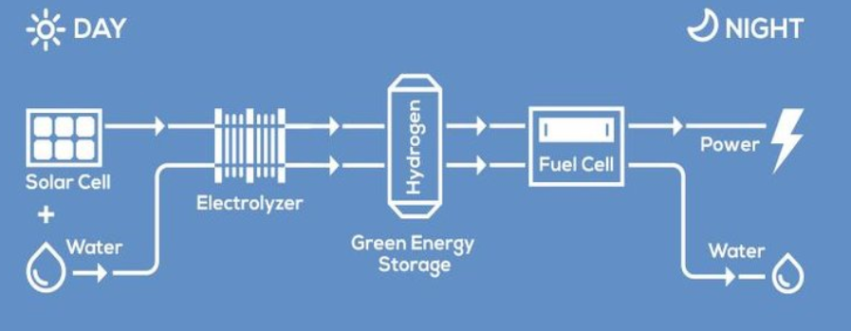
Green Hydrogen based Microgrids
Self-sustaining standalone system
Cost of power supply
Resources required
No fuel logistics involved
Completely green
Suitable for off-grid/remote locations
Cost parity with diesel power
Few moving parts - low maintenance
Solar irradiance
Water for generation of hydrogen
No risk of diesel/kerosene price escalation for the next 25 years
14

Slide 15
DG vs Green Hydrogen Microgrid
Diesel Generator
Expensive and Difficult Logistics of Fuel (Diesel) Price to increase in future years
High local Pollution, health issues for personnel
High Maintenance and replacements due to extreme weather
Increases crude imports
Cost of Electricity ~ ₹45-55/kwh
Green Hydrogen Microgrid
Self Sustaining – No Fuel required
Zero Emissions
Low Maintenance
Decreases crude imports (ATMANIRBHAR)
Cost of Electricity ₹50-55/kWh, levellised for next 25 years
15

Slide 16
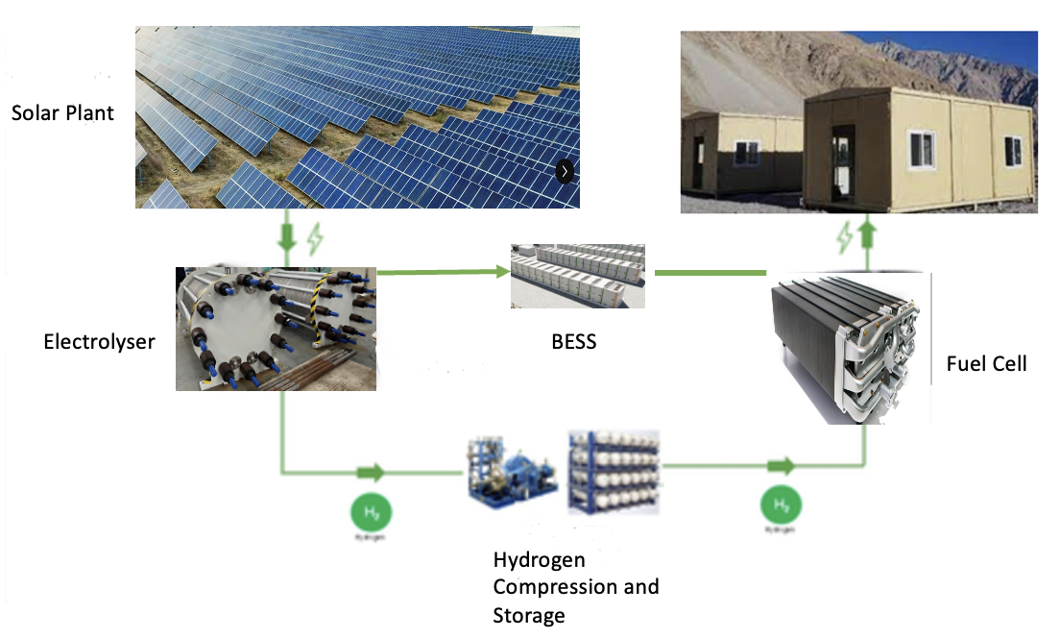
About the High Altitude Project
3.2 MW
Note: Due to high altitude the systems will be oversized accordingly, the above-mentioned values are minimum
1 MW PEM
0.3 MW/1.2 MWh
200 kW
200 kg H2 @ 250 Bar
Broad Schematic of the system
16

Slide 17
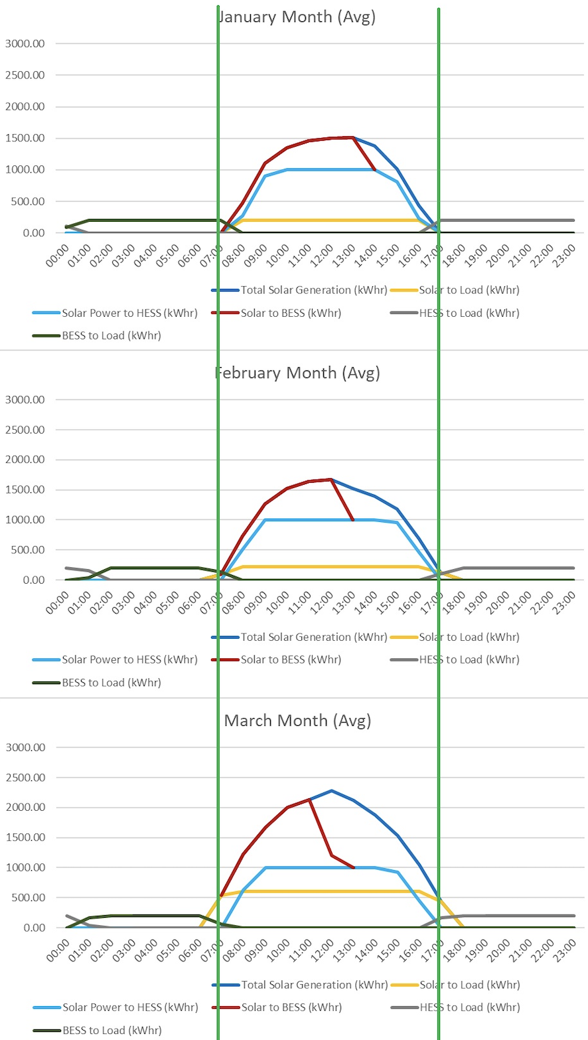
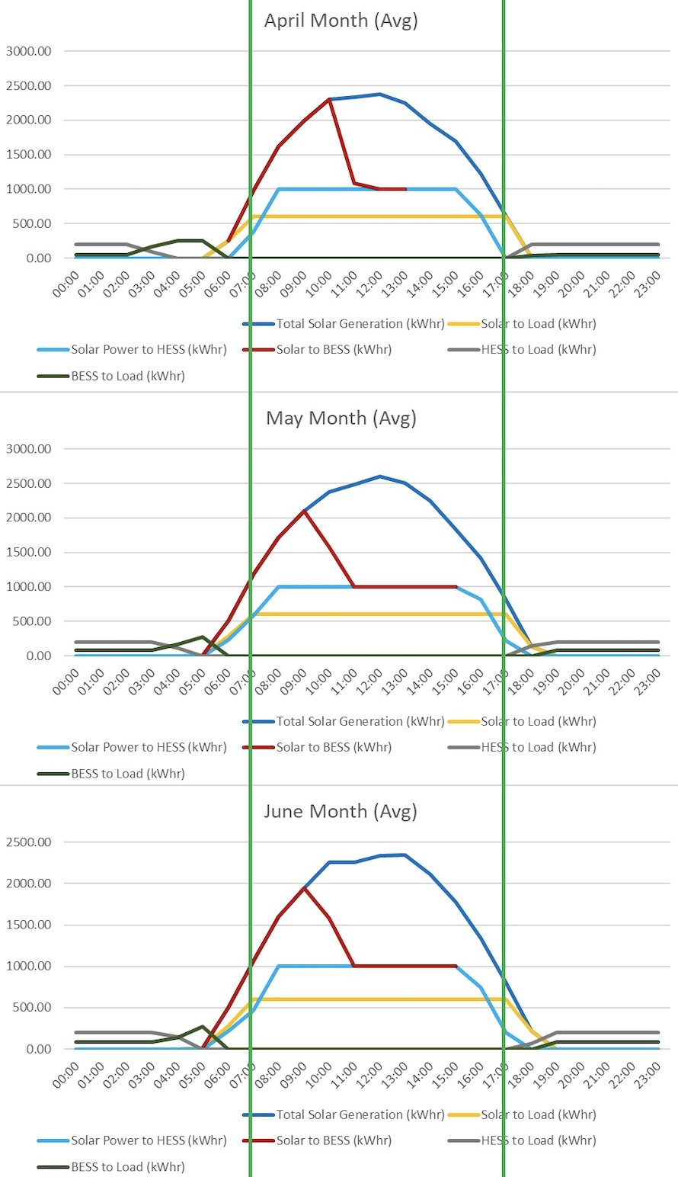
Month-wise Daily Average Energy Profile
17

Slide 18
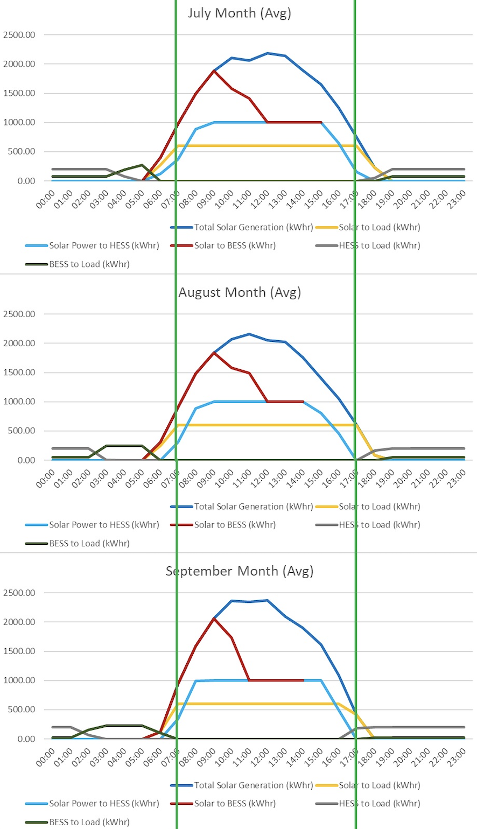
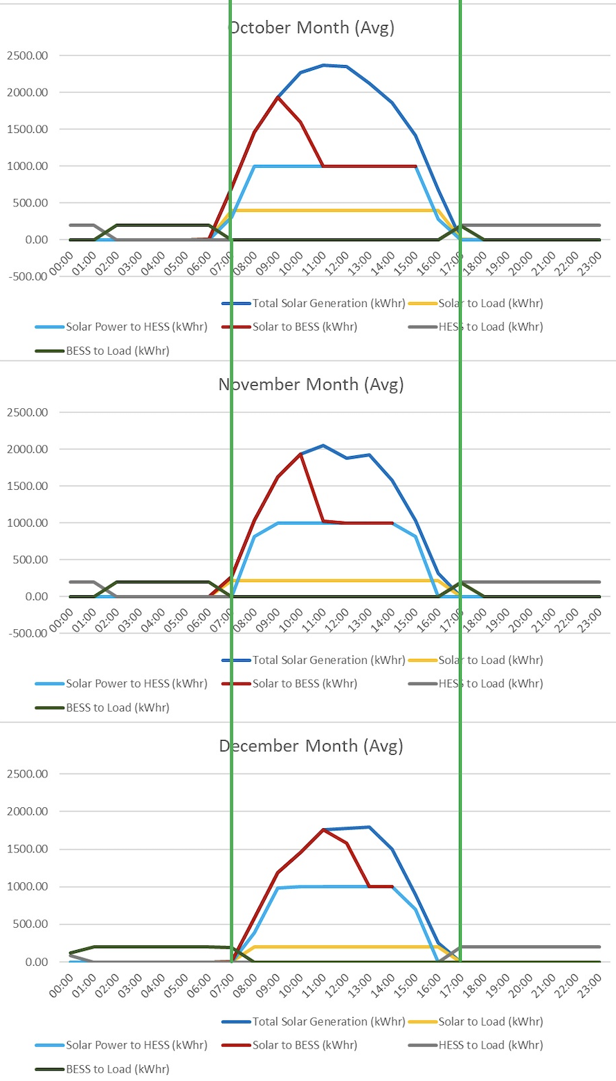
Month-wise Daily Average Energy Profile
18

Slide 19
Taking up the Challenge
Extreme Weather Conditions
Small Working window in the year
Derating of Fuel Cell due to High Altitude
Additional Logistics Cost
Additional Manpower cost
Thermal Management is the key

Slide 20






Migratory Birds at NTPC Dadri
Thank You
NTPC Ramagundam
Website: www.ntpc.co.in
Follow us on:
/ntpc1
/ntpcltd1
/ntpclimited
/Company/ntpc
/ntpclimited

Slide 21
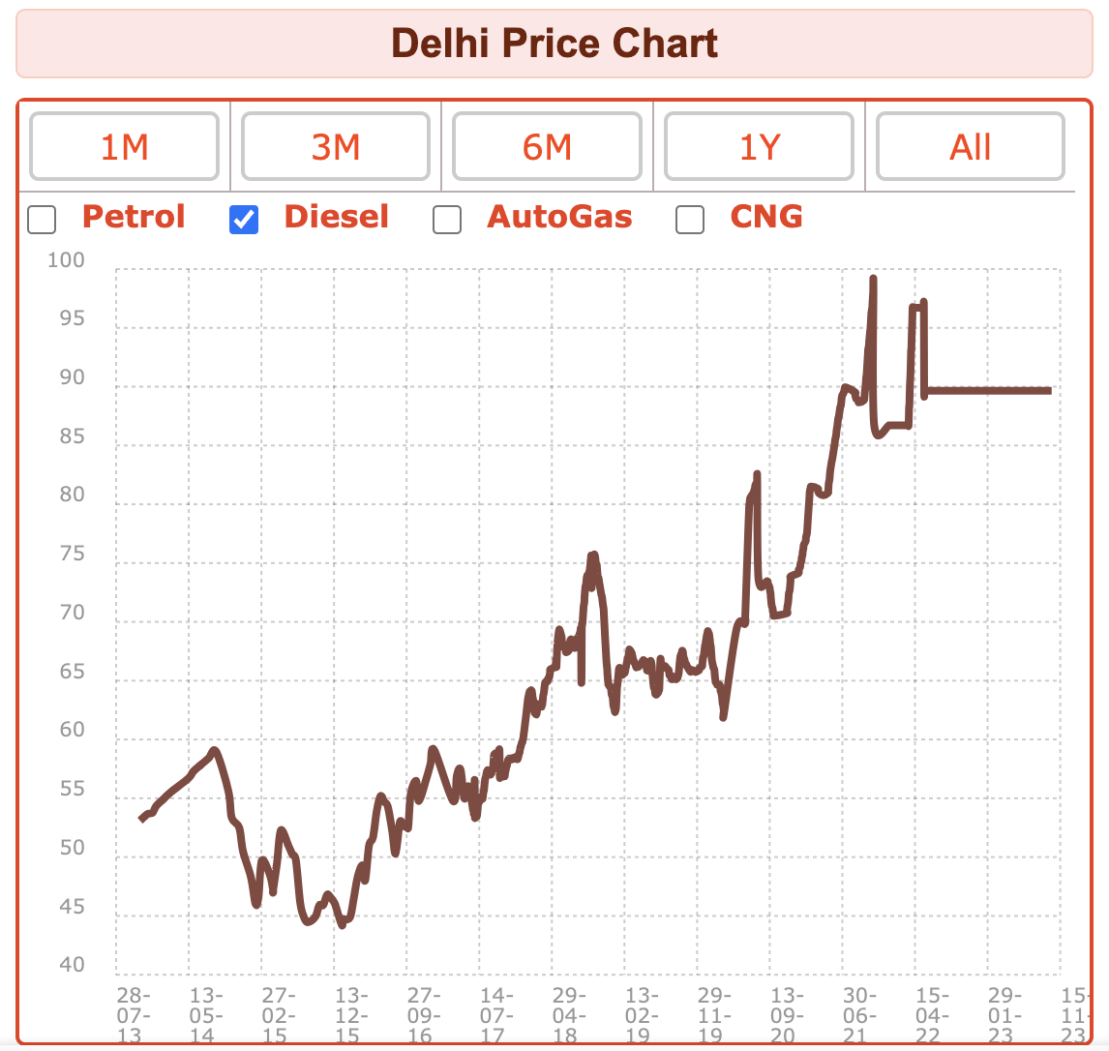
Diesel Price trend in last 10 years
7.2% CAGR
Ref: mypetrolprice.com
21

